Slide 1
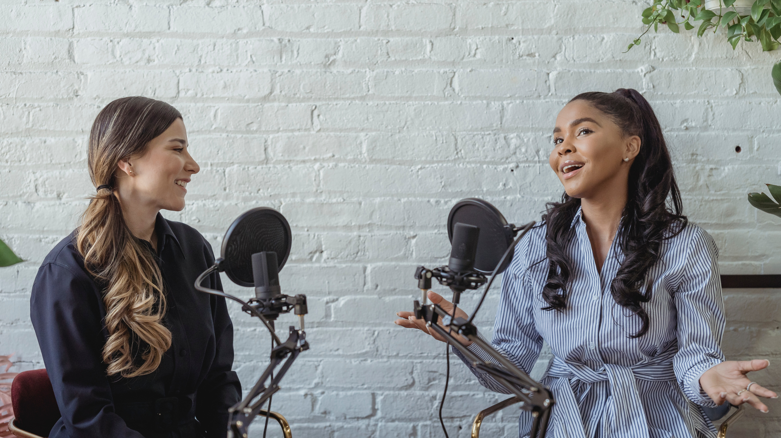
How to Start a Podcast
Konstantinos Karagiannis
Director, Quantum Computing Services
Host of:

Slide 3
Too Late to Start? No!
Over 4 million podcasts worldwide
Only 720K have more than 10 episodes
464 million listeners worldwide
About a third of US citizens listen
Second-most popular US podcast started 2021!
Most advertisers from TV and radio haven’t migrated yet

Slide 4
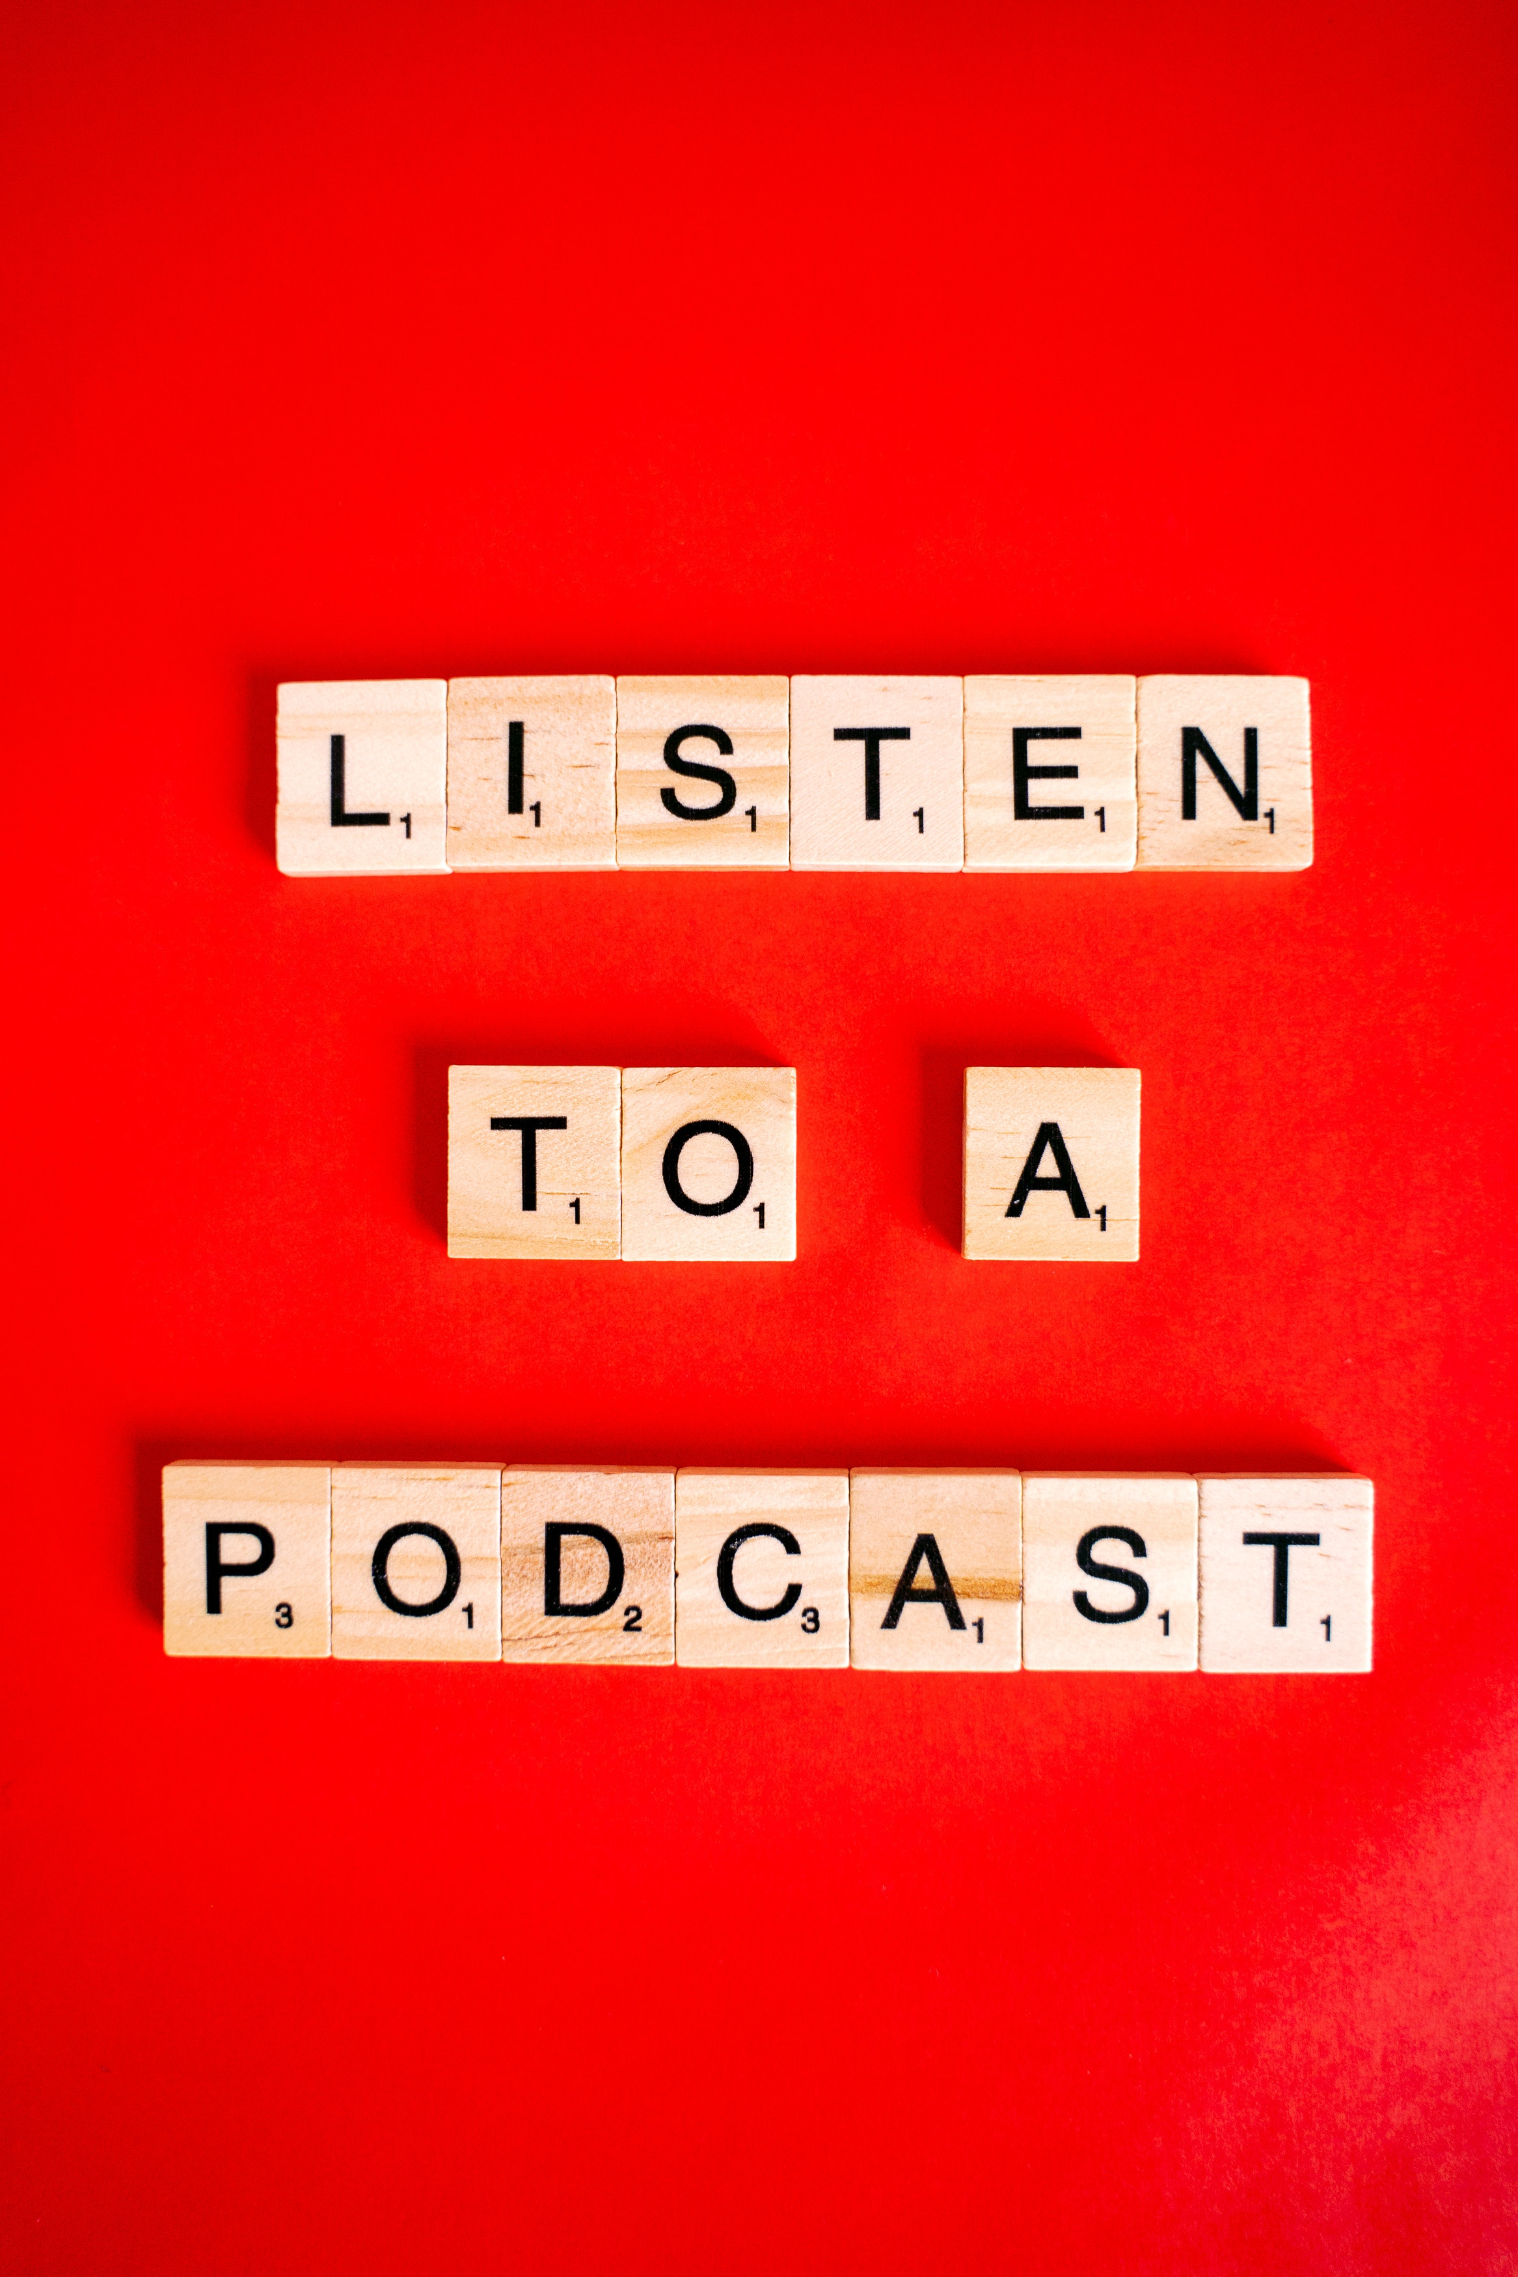
Why Start One?
Listen to lots of them—top ones and niche—what do you want to add?
Personal passion
Business booster
Boost your company’s brand
Build your own credibility in your field

Slide 5
Develop a Concept
Notes on Design Thinking
Biz or personal, choose a topic you’re passionate about
Define target audience and niche—try to differentiate, make a twist
Write an elevator pitch
Come up with an original title that captures the above

Slide 6
Cover Art
Shows in player
1400x1400 up to 3000x3000 pixels
Design with AI?

Slide 7
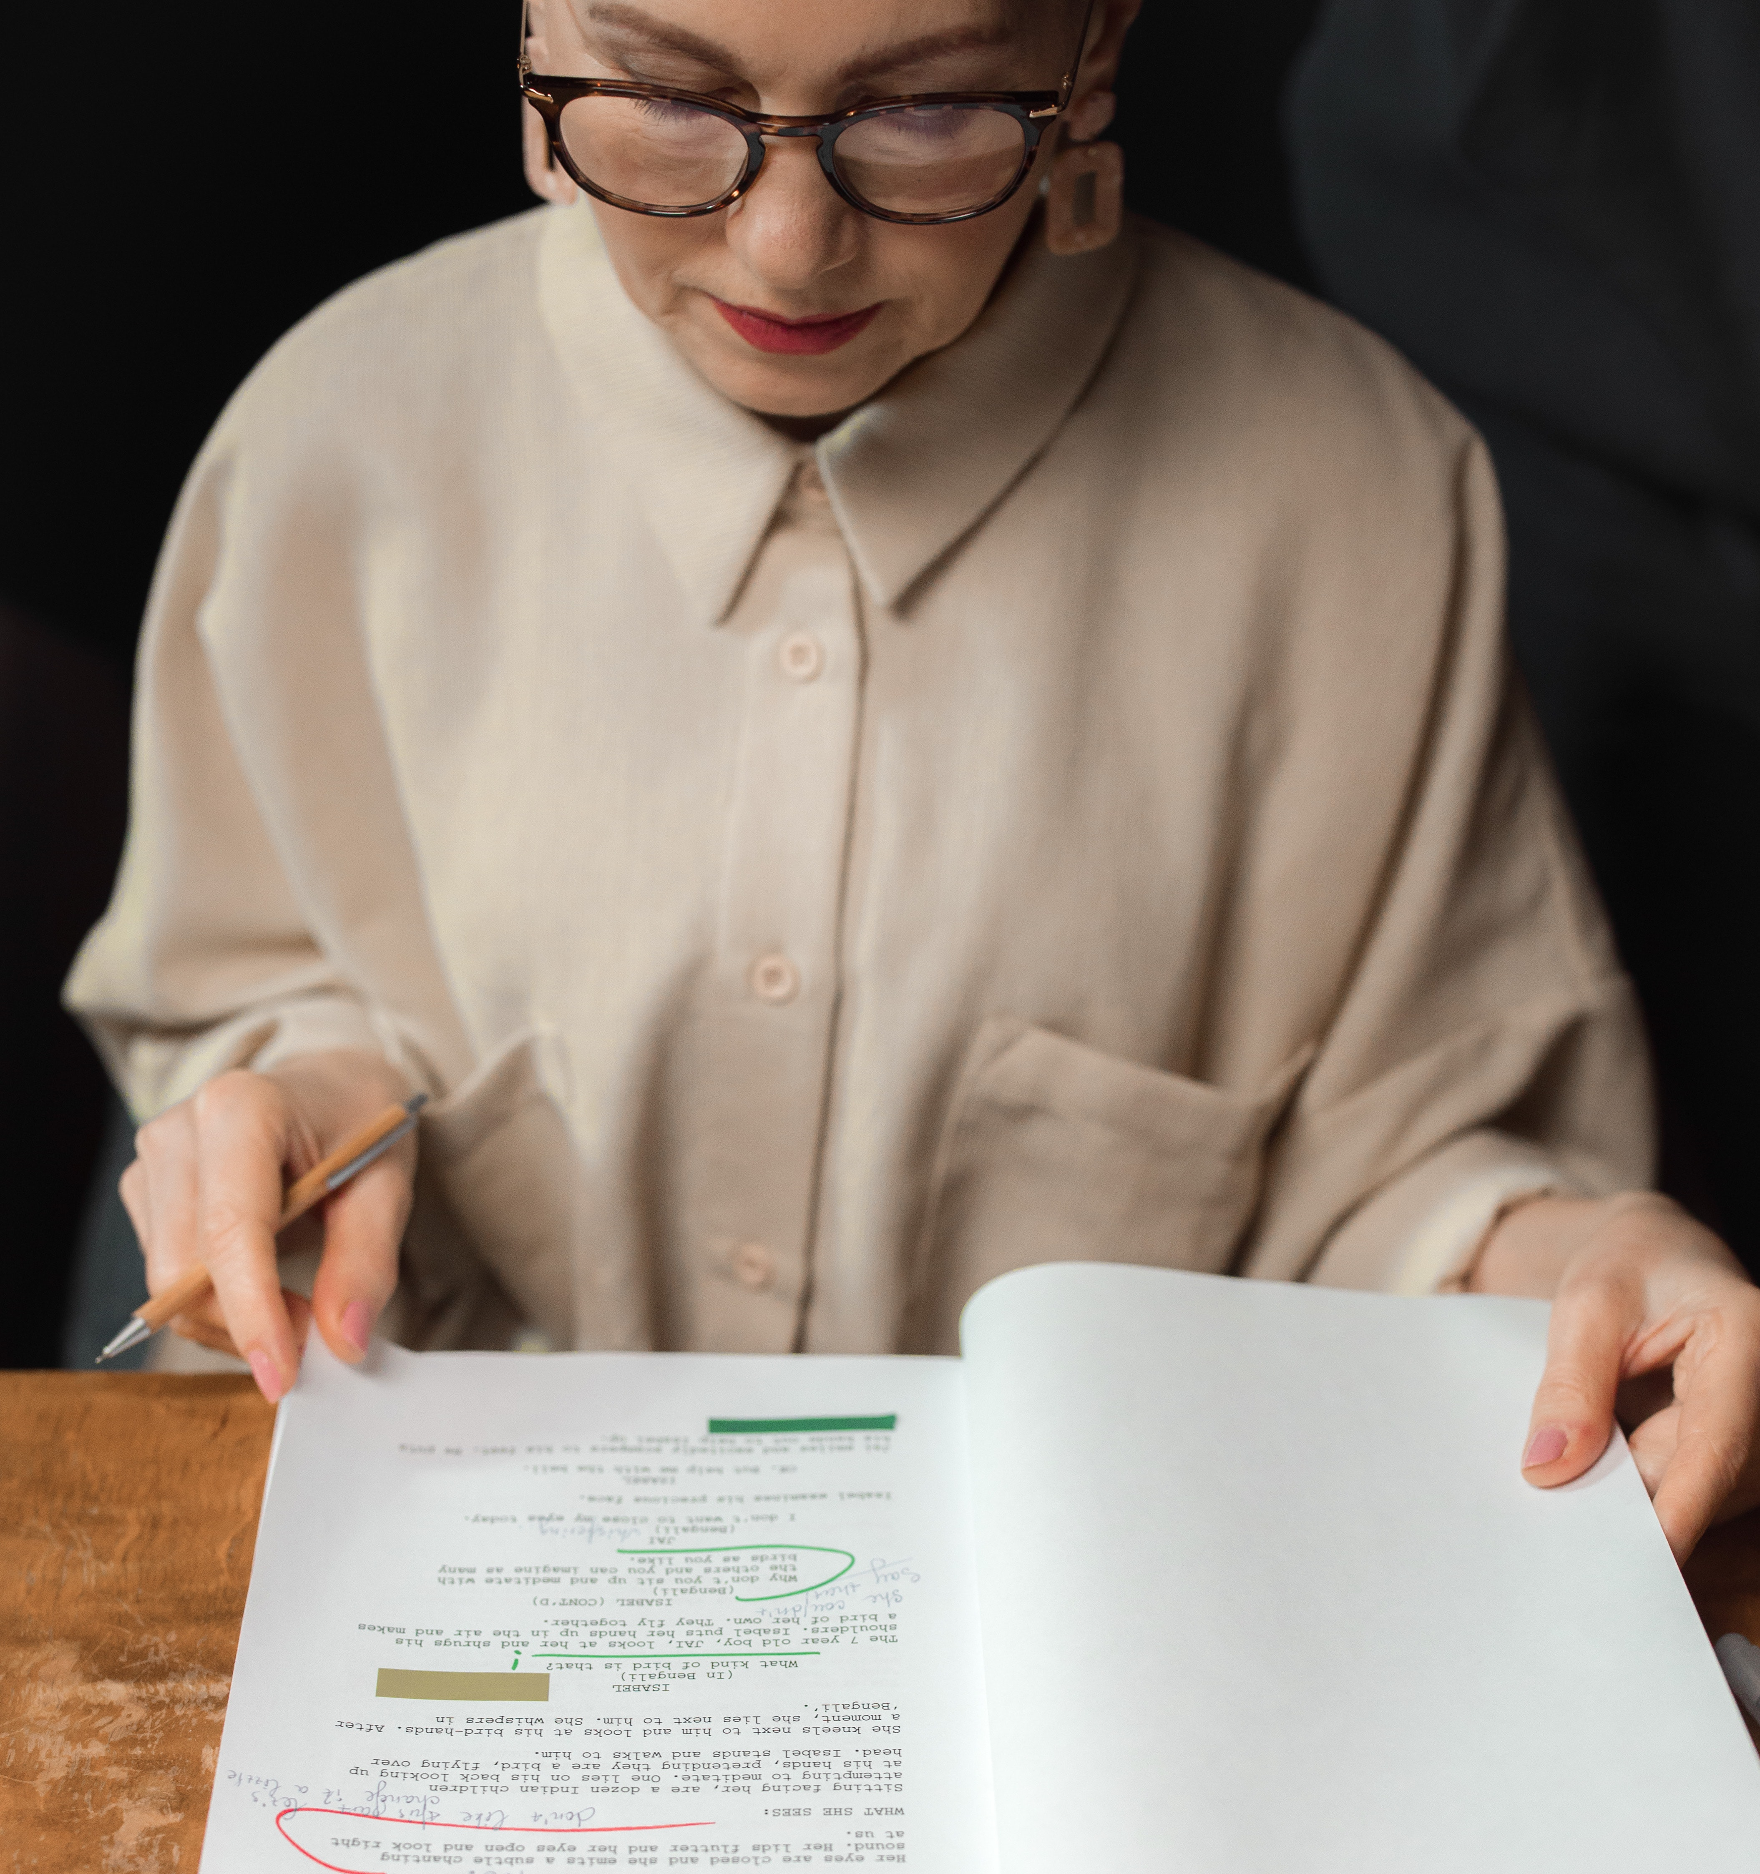
Choose Your Format
Length, frequency, style
Imagine wildly! Think audio Netflix
Solo, cohosted?
Interview format?
Planning structure and scripts. How I do it.

Slide 8
Getting Guests
Your network and relationships
Twitter
News in your field
Poach guests from other shows
Trade show speakers

Slide 9
Performance Basics
Bring it!
Ethos (authority), Pathos (emotion), and Logos (logic).
Accuracy over breadth.
Research—okay to pause and check.
Listen for, uhm, ticks.
Make guests sound better, too.
Cut out pauses in editing.

Slide 10
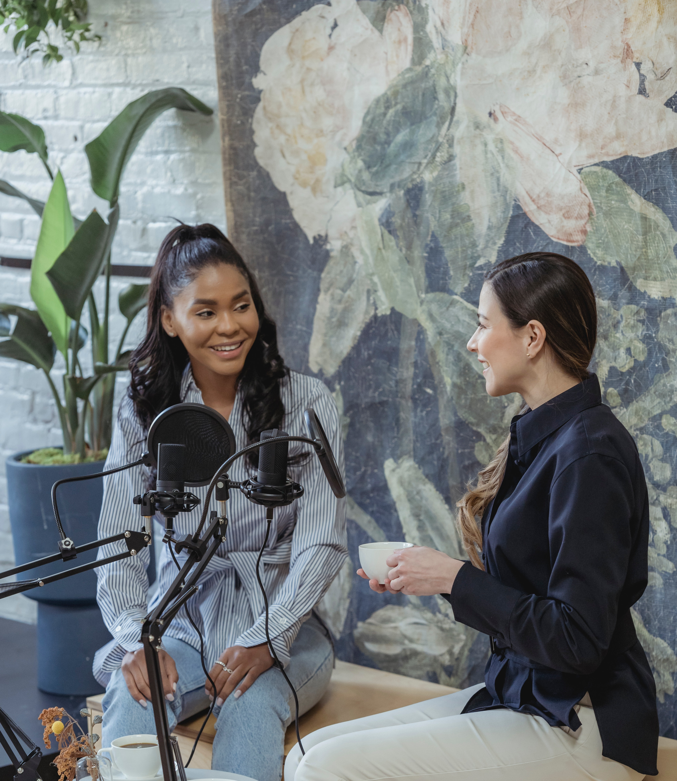
Interviewing
Note questions you like in other shows
Research your guest and their company
Prepare 12-15 questions for 30 minutes
Listen carefully and interject follow-ups
Try to frontload important questions
Be original, especially with popular guests
“Yes, and…”
Legal disclaimers

Slide 11
Tech

Slide 12
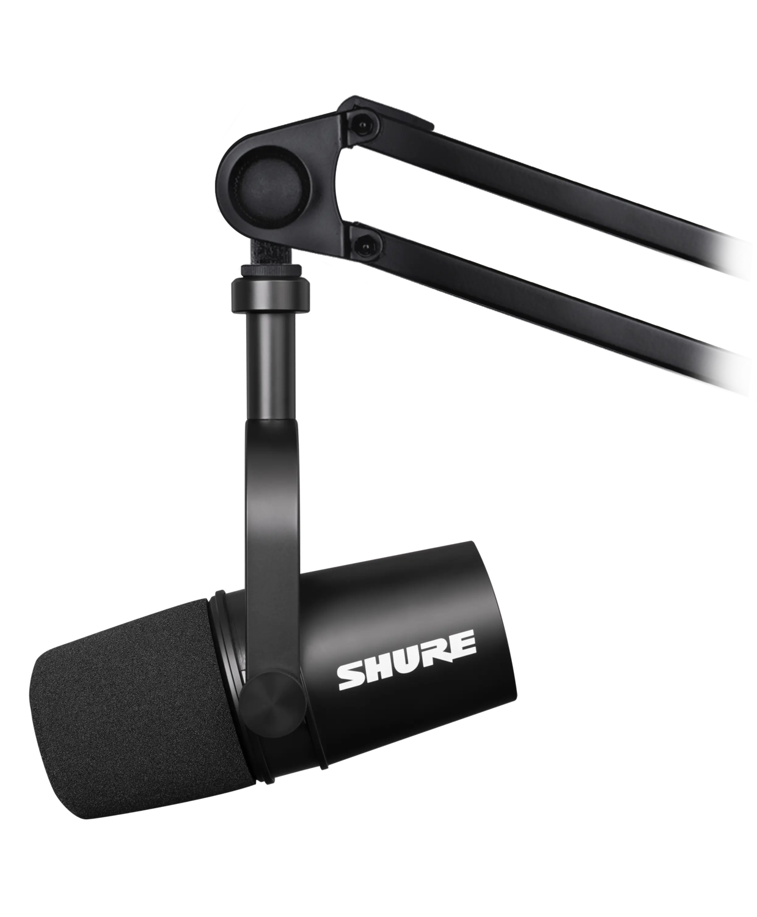
Mic Up
Dynamic vs. Condenser
Cardioid vs. Omnidirectional
USB vs. XLR
Windscreen or plosive/pop shield
Proper technique

Slide 13
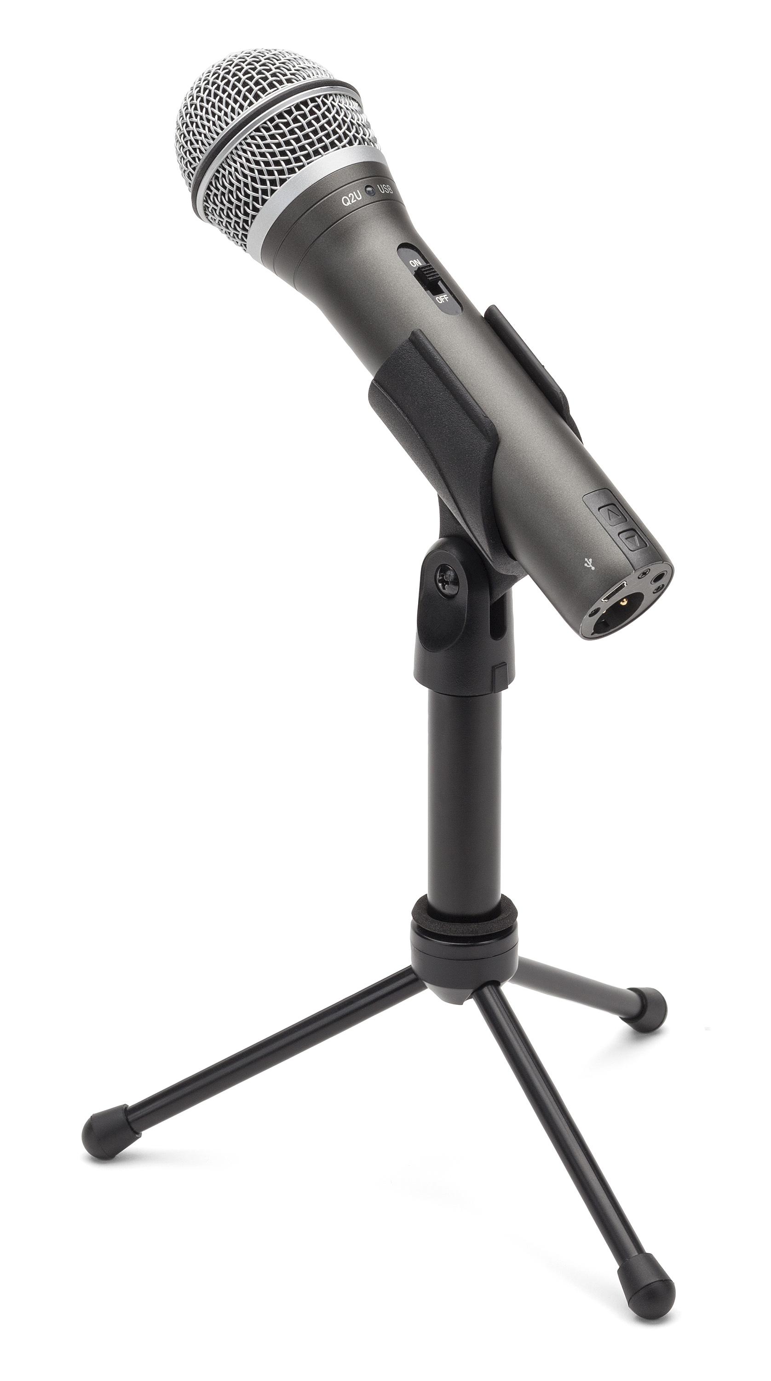
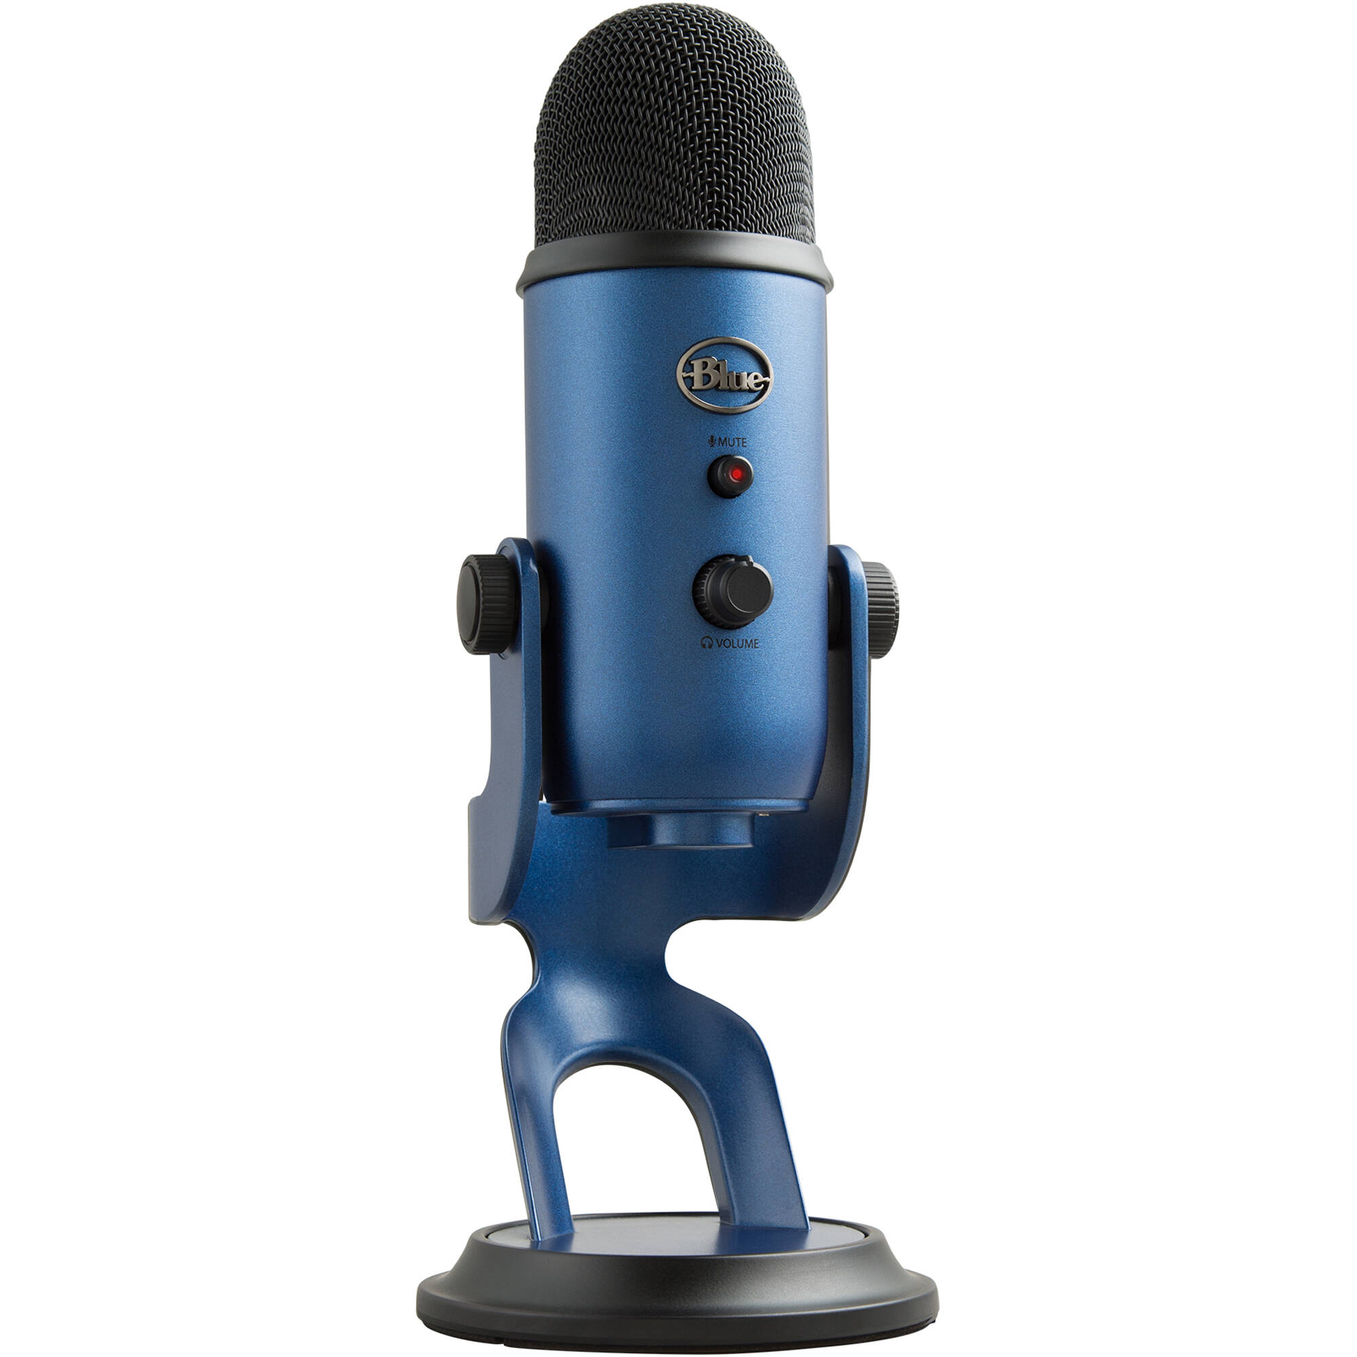
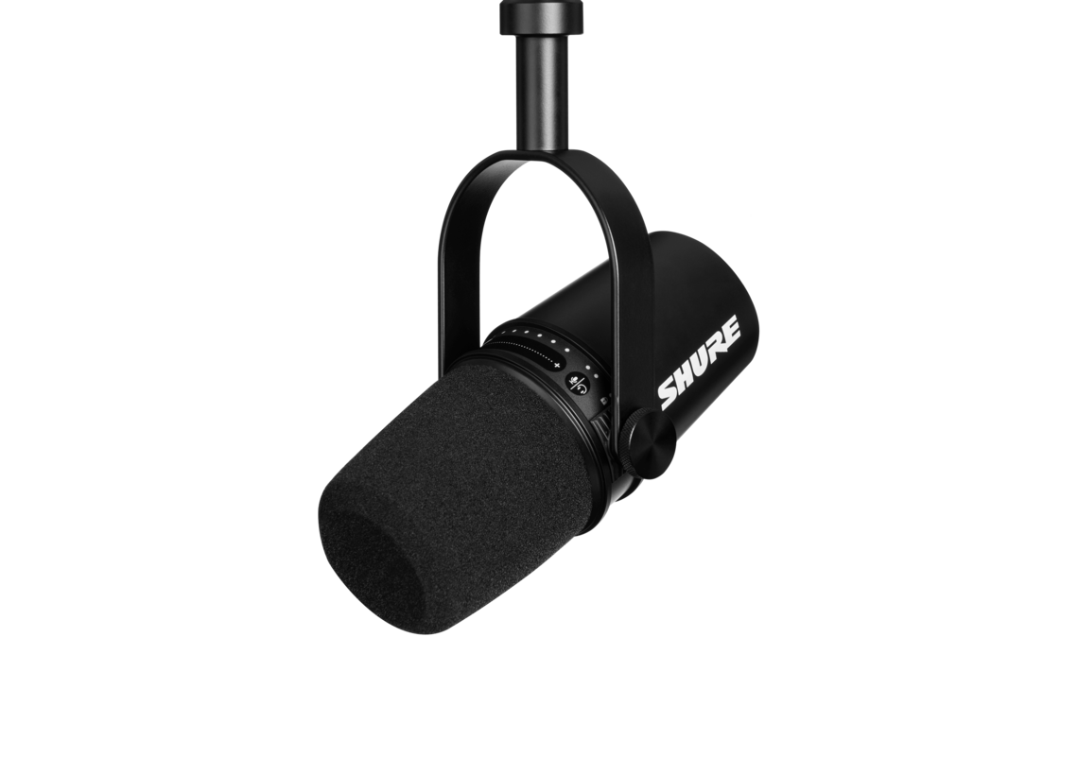
Mics
Behringer XM8500 Dynamic XLR – $30
Samson Q2U Dynamic USB/XLR – $50
Blue Yeti Condenser USB – $130
Shure mv7X Dynamic XLR – $180

Slide 14
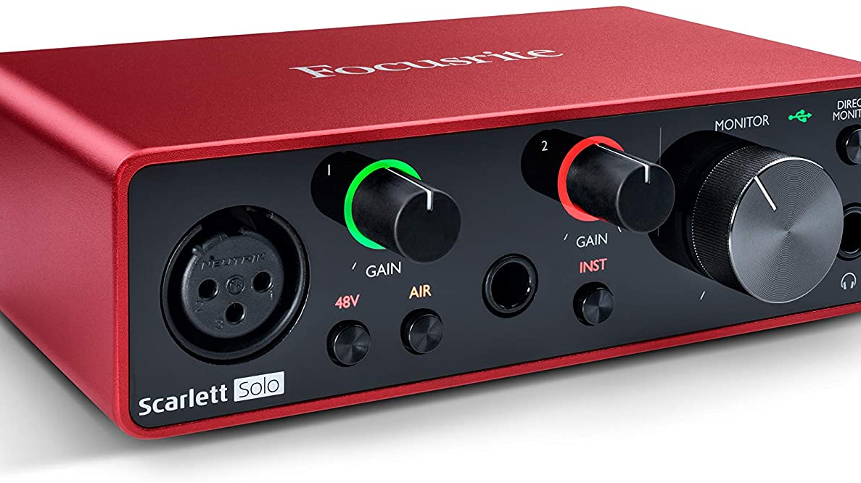
The Interface of Choice
Focusrite Scarlett Solo – $130

Slide 15
Recording Environment
In-person or remote?
In-person requires multiple mics, windscreens, stands, and a mixer ($200 and up) instead of the Solo
Treatment of room—go for a closet sound
Backup: Two is one, one is none

Slide 16
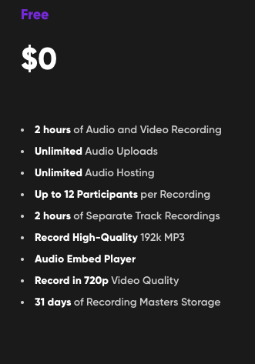
Recording Online
Zencastr (free and up, see right)
Riverside starts at $15 for 5 hours (free is watermarked)
Both let you record locally in browser, download files for mixing
You can record in Teams, but…

Slide 17
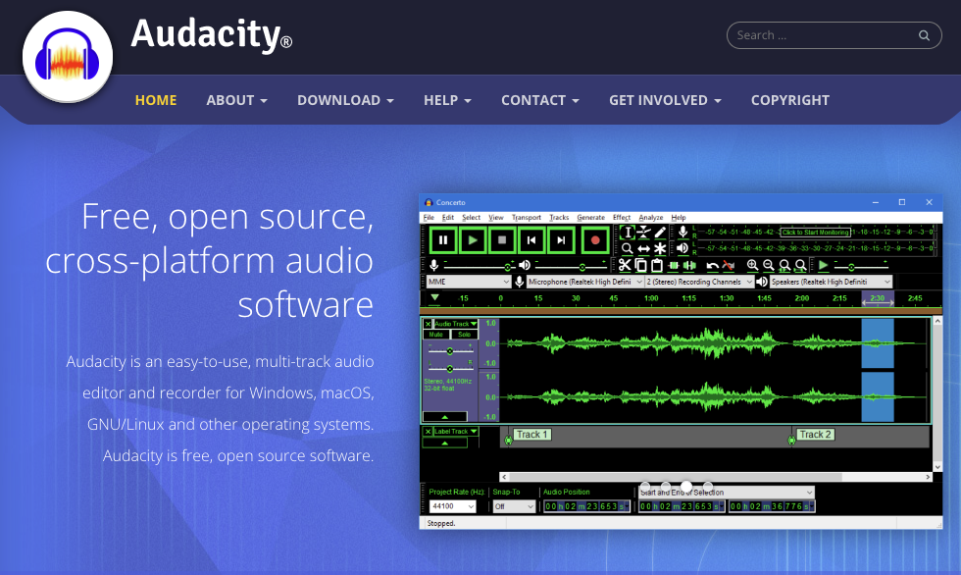
Editing
Audacity, powerful and free DAW
Intro/Outro, music (copyright!)
Mixing tracks
Cutting noises and gaps
Tagging files and metadata
Outsource? Fiverr and UpWork

Slide 18
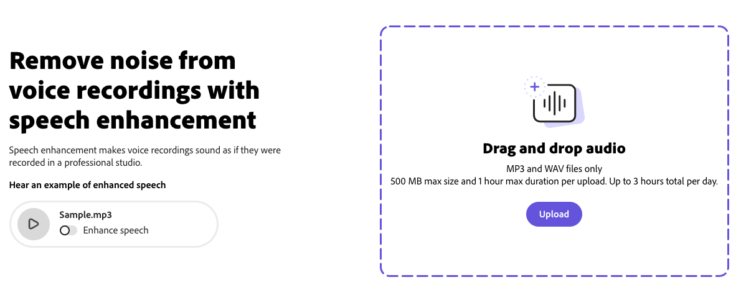
Other Sound Advice
Adobe tool can improve audio with AI
https://podcast.adobe.com/enhance
Levelator is a free app that normalizes
Use mono for most shows

Slide 19
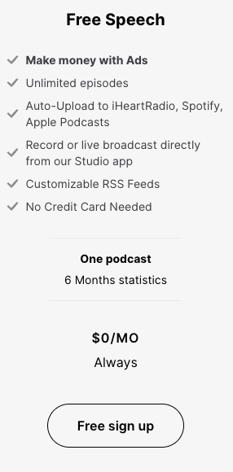
Hosting
Hosting service pushes to Apple or Spotify
We use Spreaker, which now has an aggressive free option
Pay versions give valuable stats that show what’s working
Show notes!

Slide 20
Monetizing (maybe) and Promoting
Business podcasts often don’t include ads—it’s kind of an ad for you
Podcast platforms are not like social media
Strategies for interacting with the audience
Be a guest on other shows

